Slide 1





DairySense AI
DairySense
AI
AI-powered livestock decision support system

Slide 2

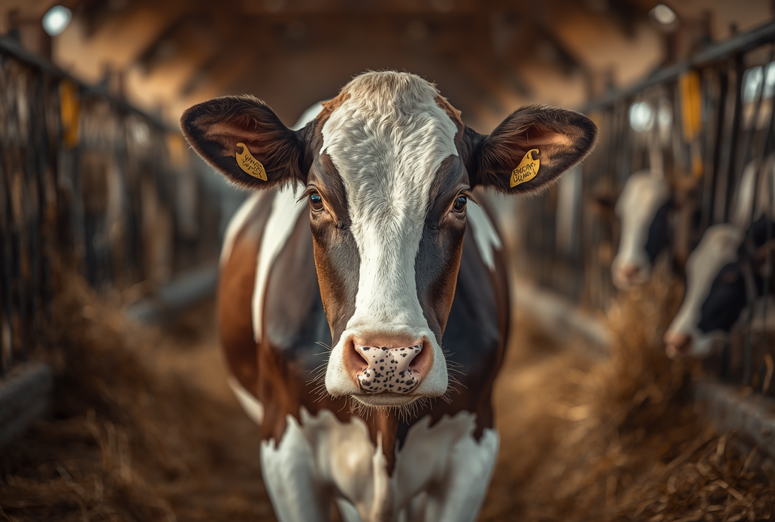
KEY CHALLENGES IN DAIRY FARMING
• Unpredictable milk yield
• Delayed disease detection
• Lack of intelligent decision support systems

Slide 3
INPUTS
Breed, Feed Quality, Lactation Stage, Ambient Temperature, and Health Symptoms are collected from the farmer and sensors as structured data.
HOW DAIRYSENSE AI WORKS
AI PROCESSING
A seamless flow from farm data inputs through AI processing to actionable outputs — empowering smarter dairy decisions.
A neural network and bio-rule engine analyze the inputs in real time, identifying patterns, anomalies, and predictive signals with high accuracy.
OUTPUTS
Milk Yield Predictions, Health Risk Alerts, and Tailored Recommendations are delivered instantly to the farmer dashboard.

Slide 4


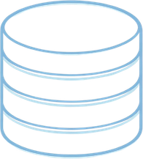
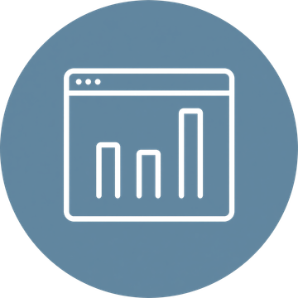

SYSTEM ARCHITECTURE
Farmer Input → Data Processing → AI Models → Bio Rule Engine → Dashboard
A seamless end-to-end pipeline delivering intelligent, real-time dairy insights.

Slide 5
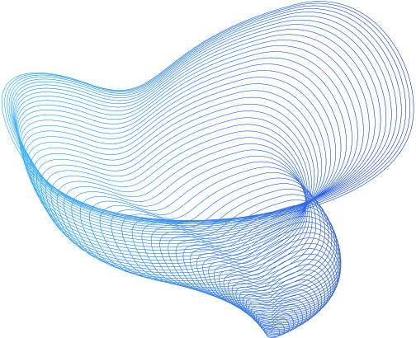
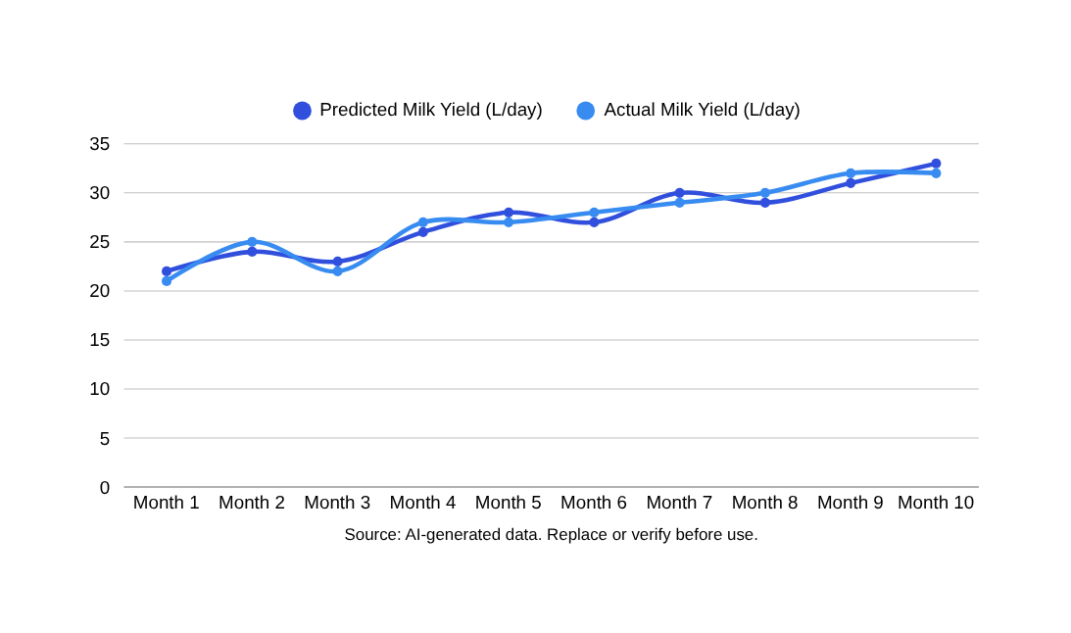
PERFORMANCE & ACCURACY
Prediction Accuracy
DairySense AI consistently outperforms traditional methods in forecasting milk yield and detecting health risks early.

Slide 6
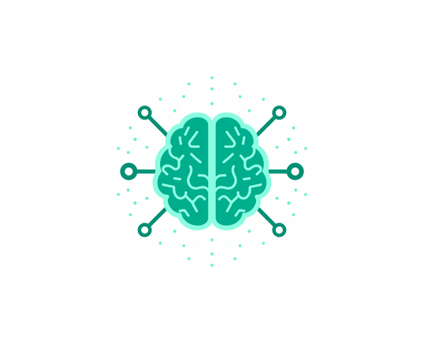

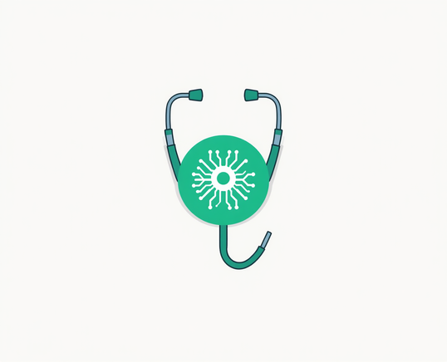
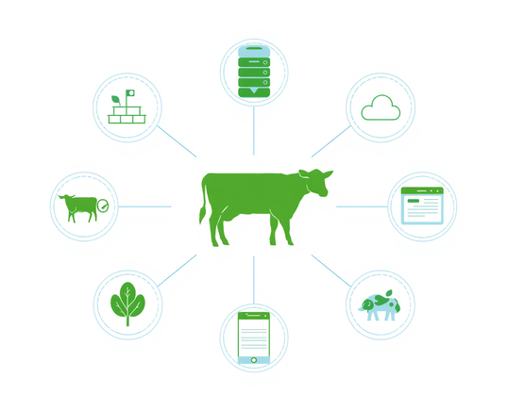
INNOVATION & FUTURE VISION
DairySense AI is built for the future — integrating AI with veterinary science, enabling early detection, and connecting the dairy ecosystem through a phased development roadmap.
Phase 1
Phase 2
Core AI & Milk Prediction
Early Disease Detection
Phase 3
Phase 4
AI + Vet Integration
Connected Dairy Ecosystem

Slide 7
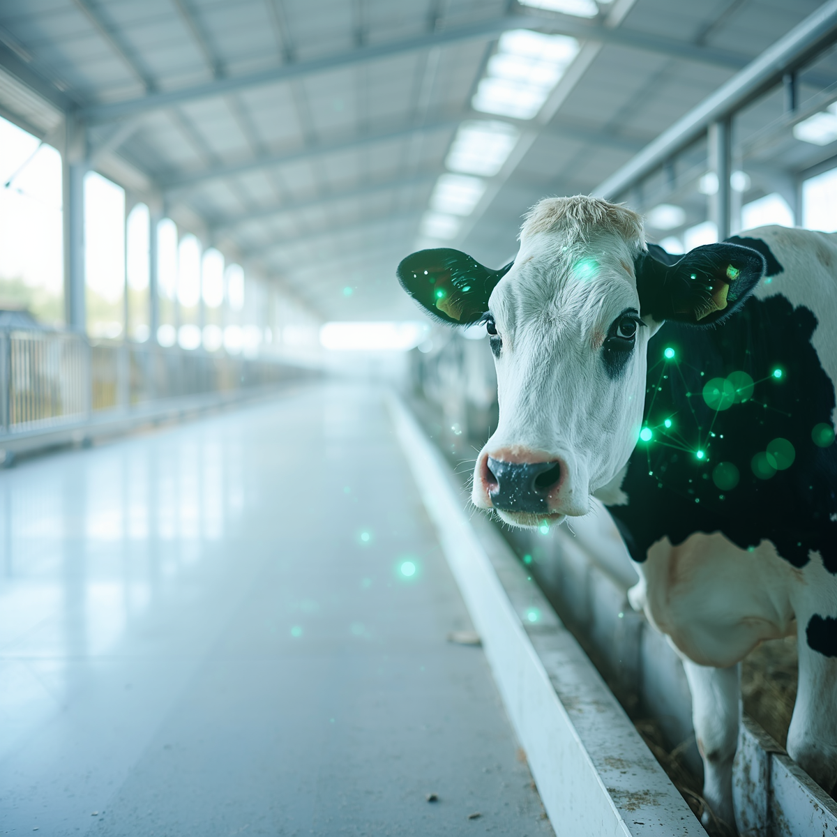
TRANSFORMING DAIRY
FROM GUESSWORK
TO INTELLIGENCE
Thank You!

